Slide 1


Green Pace
Security Policy Presentation
Developer: Dan Taylor

Slide 2

OVERVIEW: DEFENSE IN DEPTH
The Green Pace Security Policy has been established to ensure that every layer of the organization is secure and held to a standard. The policy utilizes the Defense in Depth (DiD) strategy to ensure that multiple layers of security exist to mitigate the risk of any breach in the system. This concept also extends the responsibility of security across the entire organization.

Slide 3
THREATS MATRIX
Likely DCL50-CPP STR51-CPP MEM56-CPP MEM51-CPP ERR51-CPP | Priority DCL50-CPP STR51-CPP MEM56-CPP MEM51-CPP
Low priority DCL51-CPP DCL03-C ERR51-CPP OOP50-CPP FIO51-CPP MSC53-CPP | Unlikely DCL51-CPP DCL03-C OOP50-CPP FIO51-CPP MSC53-CPP

Slide 4
10 PRINCIPLES
Validate Input Data
STD001-CPP
Heed Compiler Warnings
STD002-CPP
STD007-CPP
Architect and Design for Security Policies
STD001-CPP
STD002-CPP
STD003-CPP
STD004-CPP
STD008-CPP
Keep it Simple
STD001-CPP
STD003-CPP
STD007-CPP
Default Deny
STD009-CPP
Adhere to the Principle of Least Privilege
STD009-CPP
Sanitize Data Sent to Other Systems
STD009-CPP
Practice Defense in Depth
STD005-CPP
Use Effective Quality Assurance Techniques
STD002-CPP
STD006-CPP
Adopt a Secure Coding Standard
STD003-CPP
STD010-CPP

Slide 5
CODING STANDARDS
Data Type (STD-001-CPP): Do not define C-style variadic functions as this can lead to vulnerabilities because they have no mechanisms to check the arguments being passed to the function.
Data Value (STD-002-CPP): Do not declare or define a reserved identifier as this will result in undefined behavior.
String Correctness (STD-003-CPP): Do not attempt to create a std::string from a null pointer.
SQL Injection (STD-004-CPP): Do not store an already-owned pointer value in an unrelated smart pointer.
Memory Protection (STD-005-CPP): Properly deallocate dynamically allocated resources.
Assertions (STD-006-CPP): Use a static assertion to test the value of a constant expression.
Exceptions (STD-007-CPP): Handle all exceptions.
Object Oriented Programming (STD-008-CPP): Do not invoke virtual functions from constructors or destructors.
Input/Output (STD-009-CPP): Close files when they are no longer needed.
Miscellaneous (STD-010-CPP): Do not return from a function declared [[noreturn]].

Slide 6
ENCRYPTION POLICIES
Encryption in rest
Encryption in rest describes when data is encrypted while it is being stored. The data may be accessible but will not be readable without a proper key. This encryption will help an organization to stay protected against attempts to steal data.
Encryption at flight
Encryption at flight describes when data is encrypted while being transmitted. Data will be encrypted while being transferred to another storage location to protect sensitive data in the event it is intercepted by an outside entity or unauthorized party. The data will not be readable without the proper key.
Encryption in use
Encryption in use describes when data is encrypted while being used and allows certain access to certain users depending on authority level or necessity. Default Deny and the Principle of Least Privilege apply in this case as this helps to ensure data is accessed only by those who have an absolute necessity to access that data.

Slide 7
TRIPLE-A POLICIES
Authentication
Authentication includes User Logins, passcode requirements, secure networks, and many more security features like multi-factor identification depending on the security level and method of access for each user.
Authorization
Authorization applies authentication features to determine the level of access given to a specific user. Must be an authorized admin with the ability to read/write/edit/delete databases and files as well as add new users and set their permissions and security levels.
Accounting
Accounting is keeping records on the features from authentication and authorization and any changes made to data within the system. Comments should be made to explain any changes to data or user fields within the system to provide increased security and accountability.

Slide 8
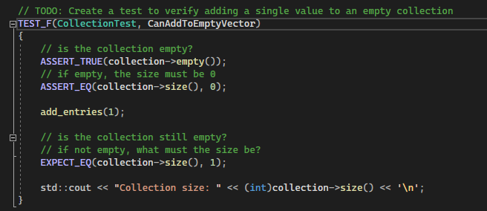
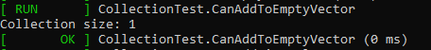
Unit Testing - CanAddToEmptyVector
The unit test checks the functionality of adding a single value to an empty collection. This is a positive test.
Code
Result

Slide 9
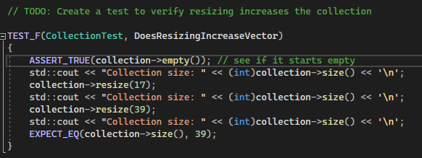
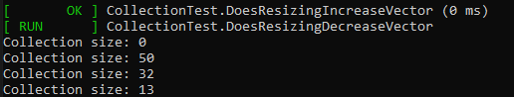
Unit Testing - DoesResizingIncreaseVector
This is a unit test to verify that resizing increases the collection. This is a positive test.
Code
Result

Slide 10

AUTOMATION SUMMARY

Slide 11
TOOLS
Automated testing should be used by an entity when developing code to ensure the programmers work is tested in a consistent manner throughout the process and that the goal of mitigating errors and vulnerabilities is achieved and sustained even after deployment. The DevSecOps automation process allows for code to be tested with little human intervention and helps to ensure that all developer’s code is tested and held to the same standards.
Lightweight Directory Access Protocol (LDAP) can be used to query user information rapidly. LDAP controls the access and maintenance of static data such as usernames, passwords, email addresses, and other sensitive.
Active directory (AD) is used to store sensitive information and is a secure way to control access to network resources.

Slide 12
RISKS AND BENEFITS
The risk of waiting to implement security policies is much greater than the risk if implementing security policies early on. By waiting, you risk time, money, and reputational damage, and if the program is completed and ends up having many vulnerabilities it would be very costly. To complete an entire program and think of security at the end is very risky.
The solution is to begin implementing security from the very start. By doing this, there is a much higher level of security throughout the program, and there is a much lower risk of a vulnerability.

Slide 13
RECOMMENDATIONS
Encryption!
Triple-A Framework
Unit Tests
Use external tools to run vulnerability checks

Slide 14
CONCLUSIONS
Security standards should be implemented starting at the beginning of the development process during the planning phase.
DiD (Defense in Depth) should be used when developing any program or system, multiple layers of security mitigate the risk of a breach even in the event one security measure fails.
Keep processes simple and efficient to minimize errors and vulnerabilities.

Slide 15
REFERENCES
SEI CERT C++ Coding Standard - SEI CERT C++ Coding Standard - Confluence. (n.d.). https://wiki.sei.cmu.edu/confluence/pages/viewpage.action?pageId=88046682

